Slide 1


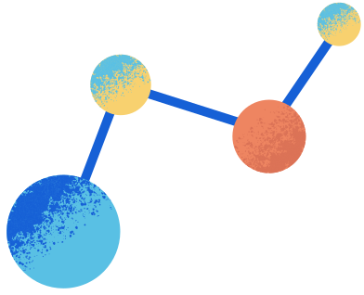
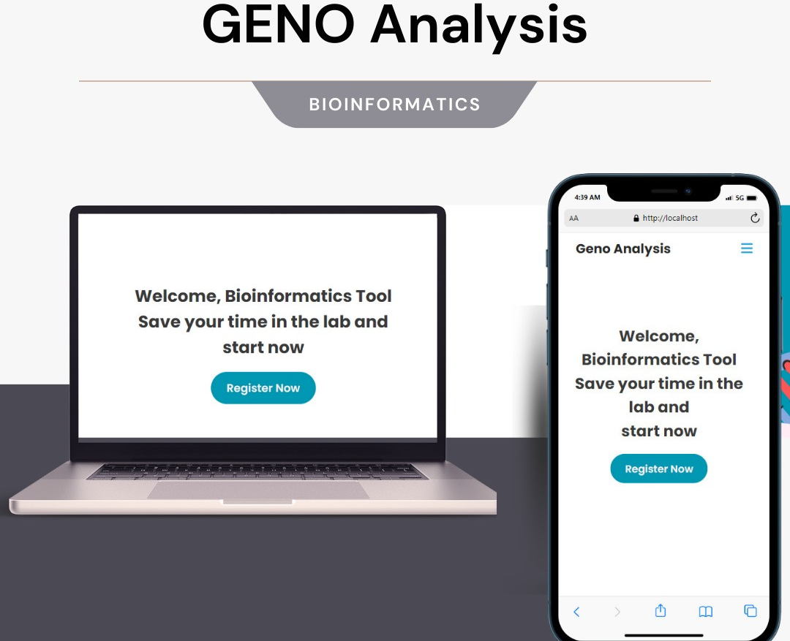
GEne anlysis

Slide 2
Names
ID
Abdallah Osama Mohamed
20198053
Amr Hosny Eid
20198059
Hadeel Salim Attia
20198097
Ahmed Ramdan
20198116

Slide 3

Introduction
This is a biological website is used for making processes on DNA gene sequence. it is easy to use and to get your information about DNA gene sequence.

Slide 4
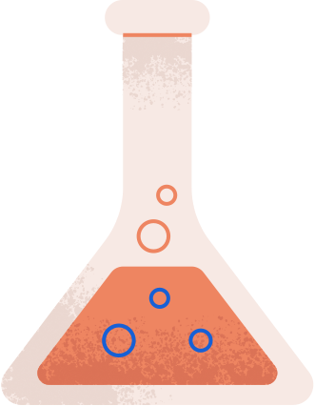
REQUIRNMENT
LOGIN/SINGUP
FUNCTIONS
user can login/sign up with email and password
user can make processes such :
Check whether DNA gene sequence has
one of these stop codon (UAG-UAA-UGA) .
Transcript DNA sequence to its RNA.
Translate RNA to its protein.
Calculate G and C nucleotides percentage in sequence (GC content).
Reverse transcription of the DNA sequence.
Get Most frequent kmer.

Slide 5
Requirnment
DATABASE
User can insert in database the result come from every function.
He can download this result on his device.
Also can Update / Delete.

Slide 6

01
REVIEW

Slide 7
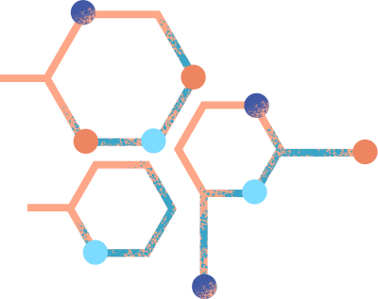
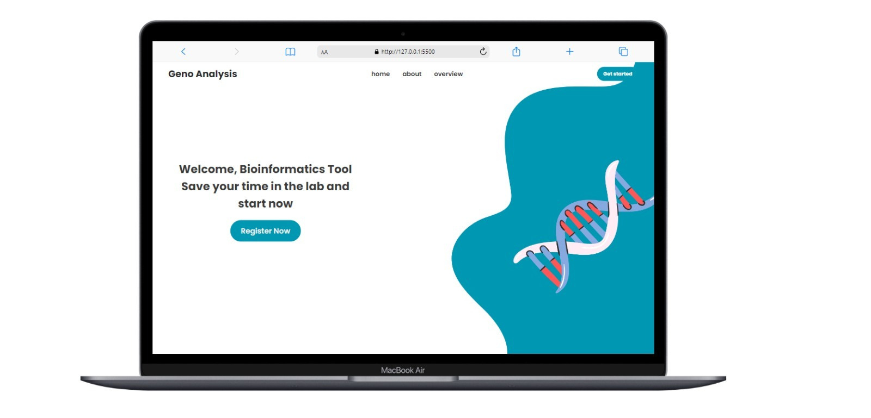
MAin page

Slide 8
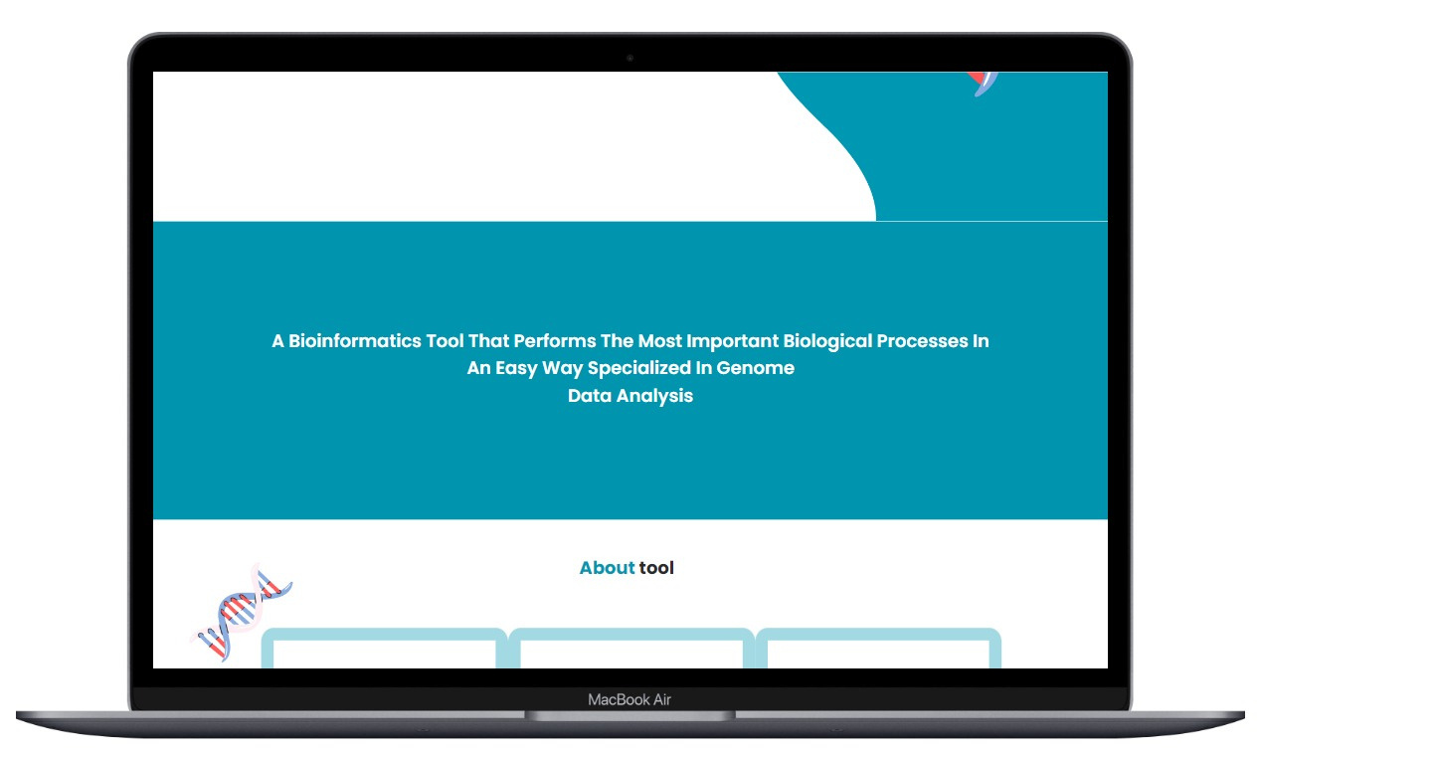
TOOL DEFINTION

Slide 9

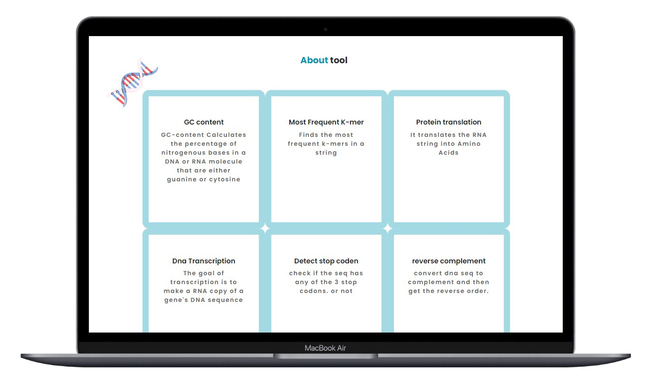

About tool functions

Slide 10

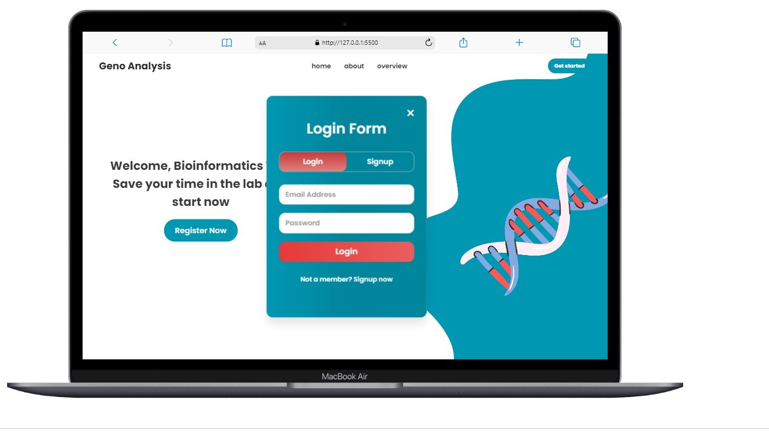
Login frist

Slide 11
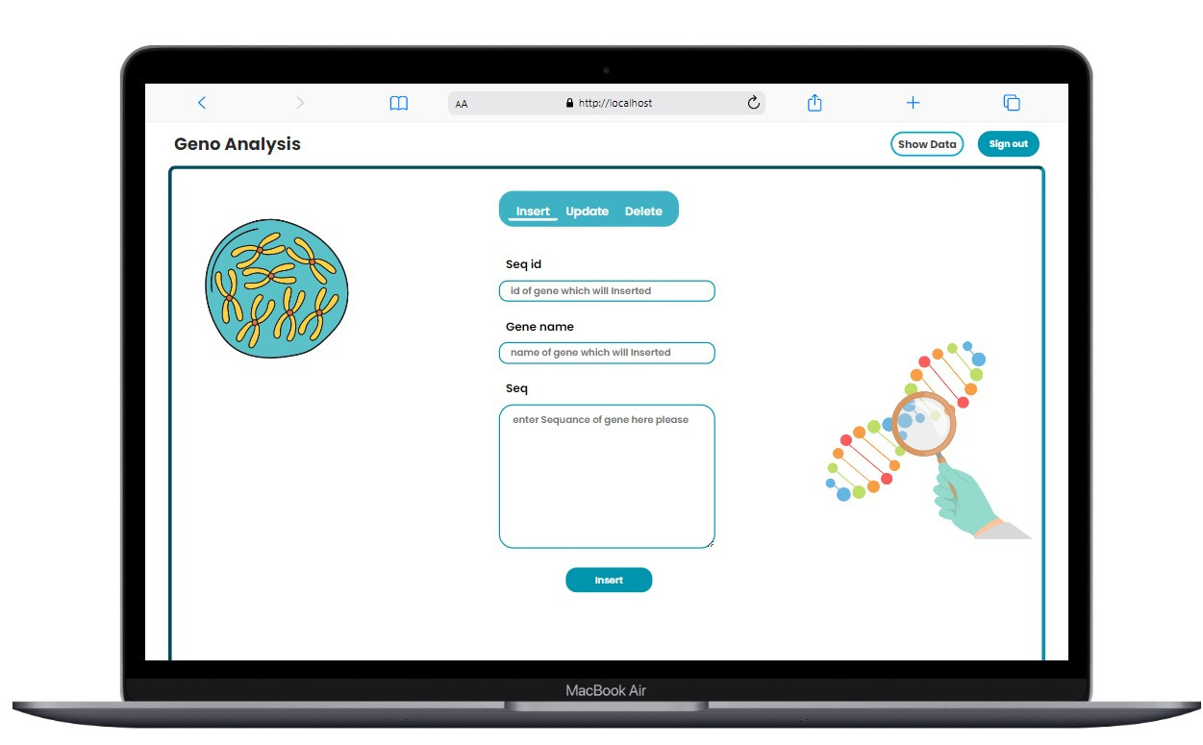

Slide 12

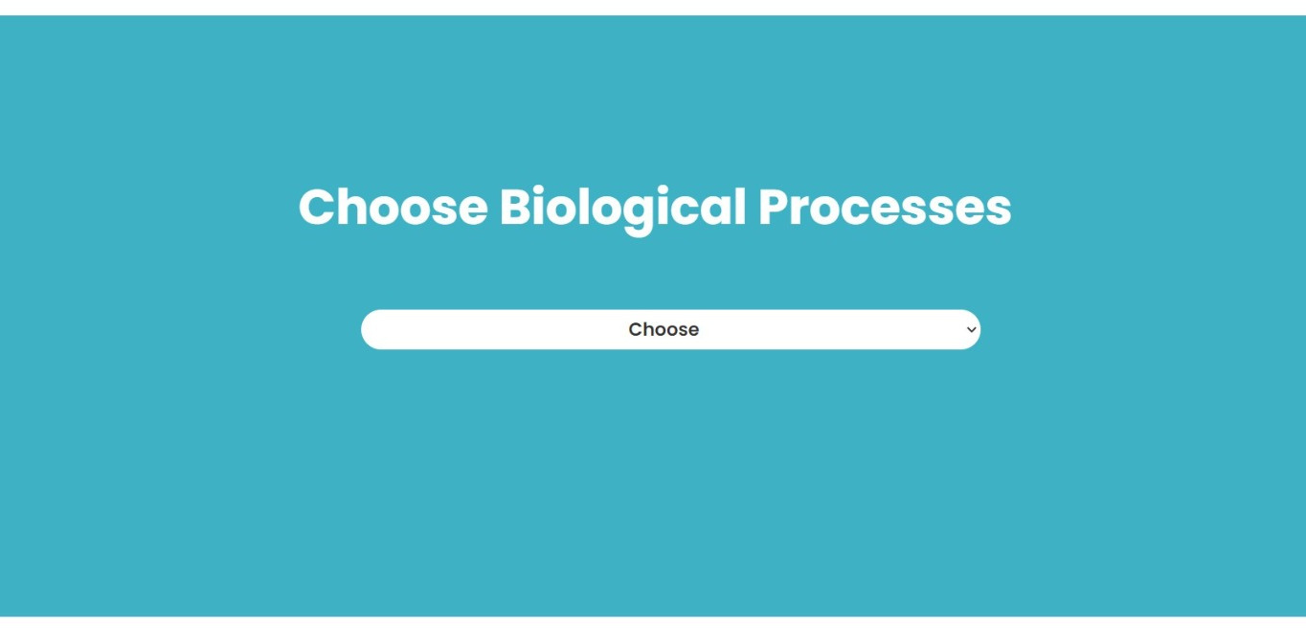


Slide 13

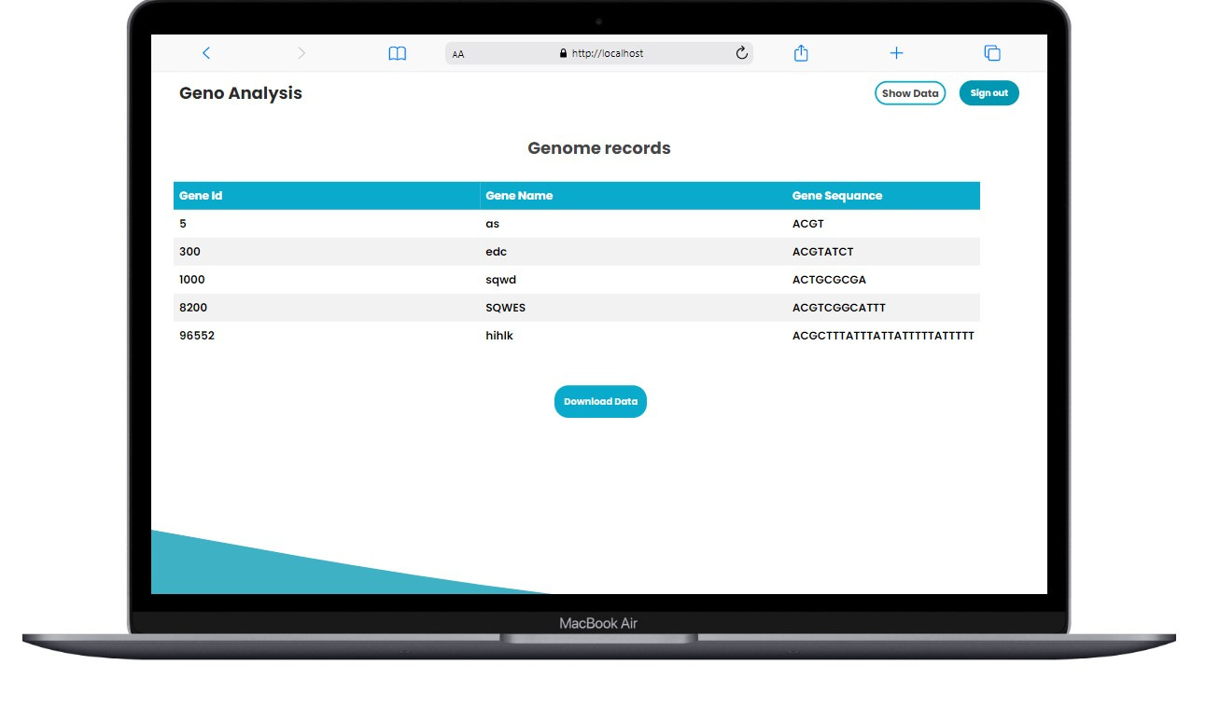

Slide 14
02
FUNCTIONS

Slide 15
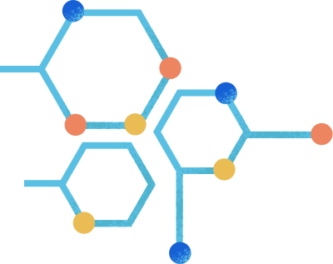
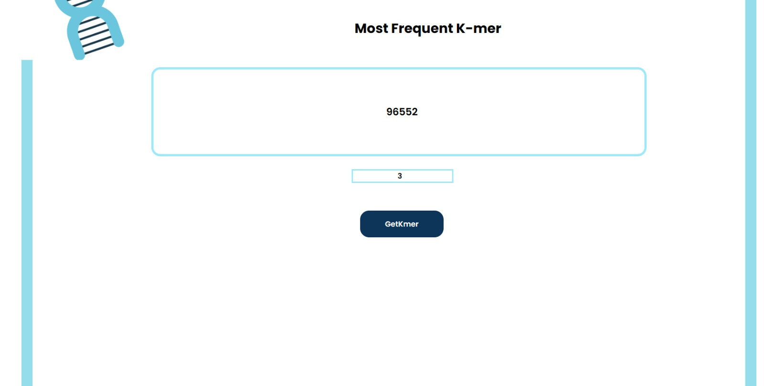
1-kmer

Slide 16
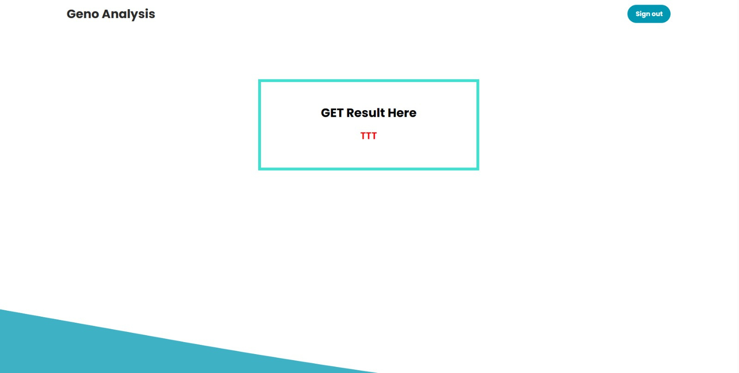
1-kmer

Slide 17
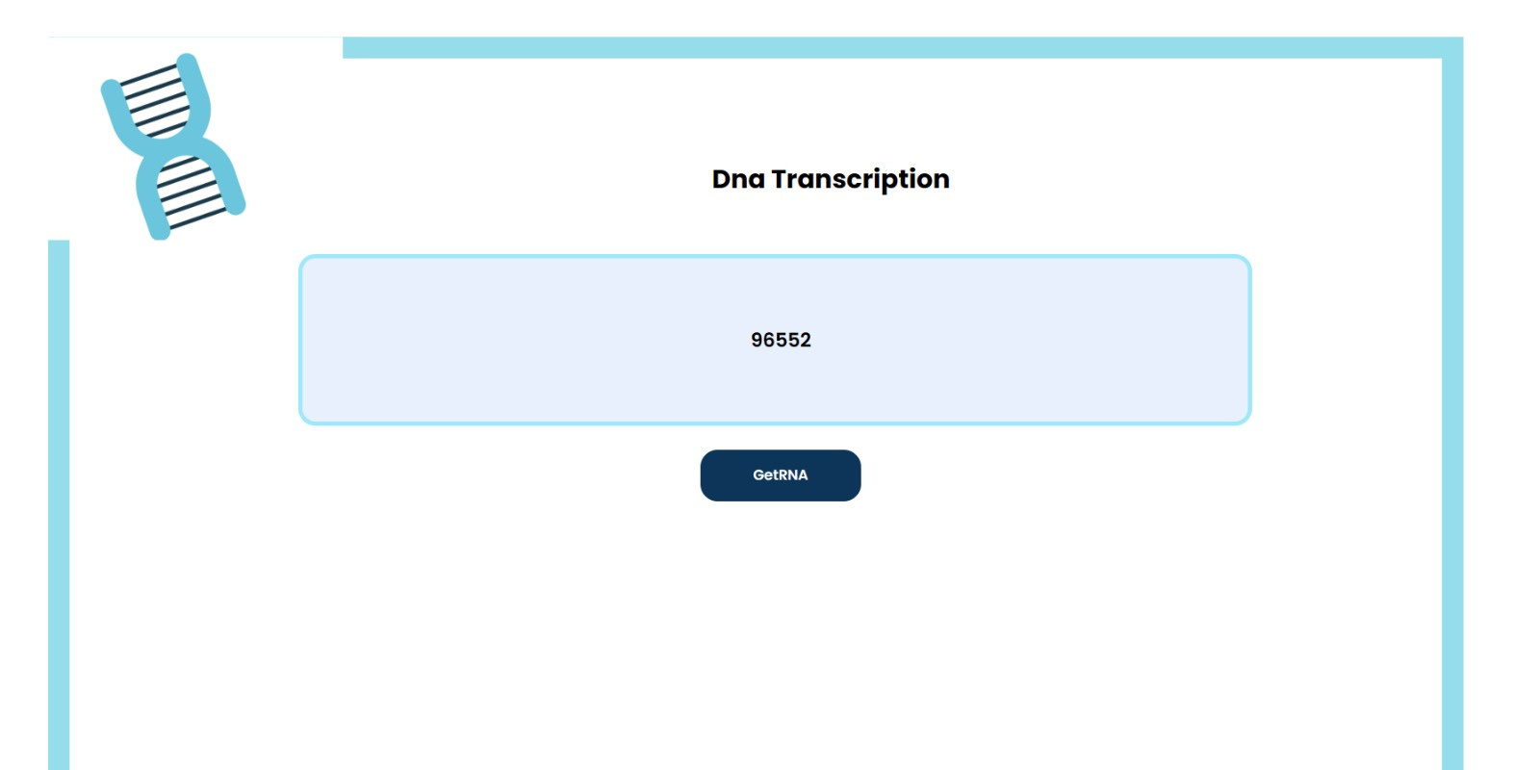
2-transcription

Slide 18
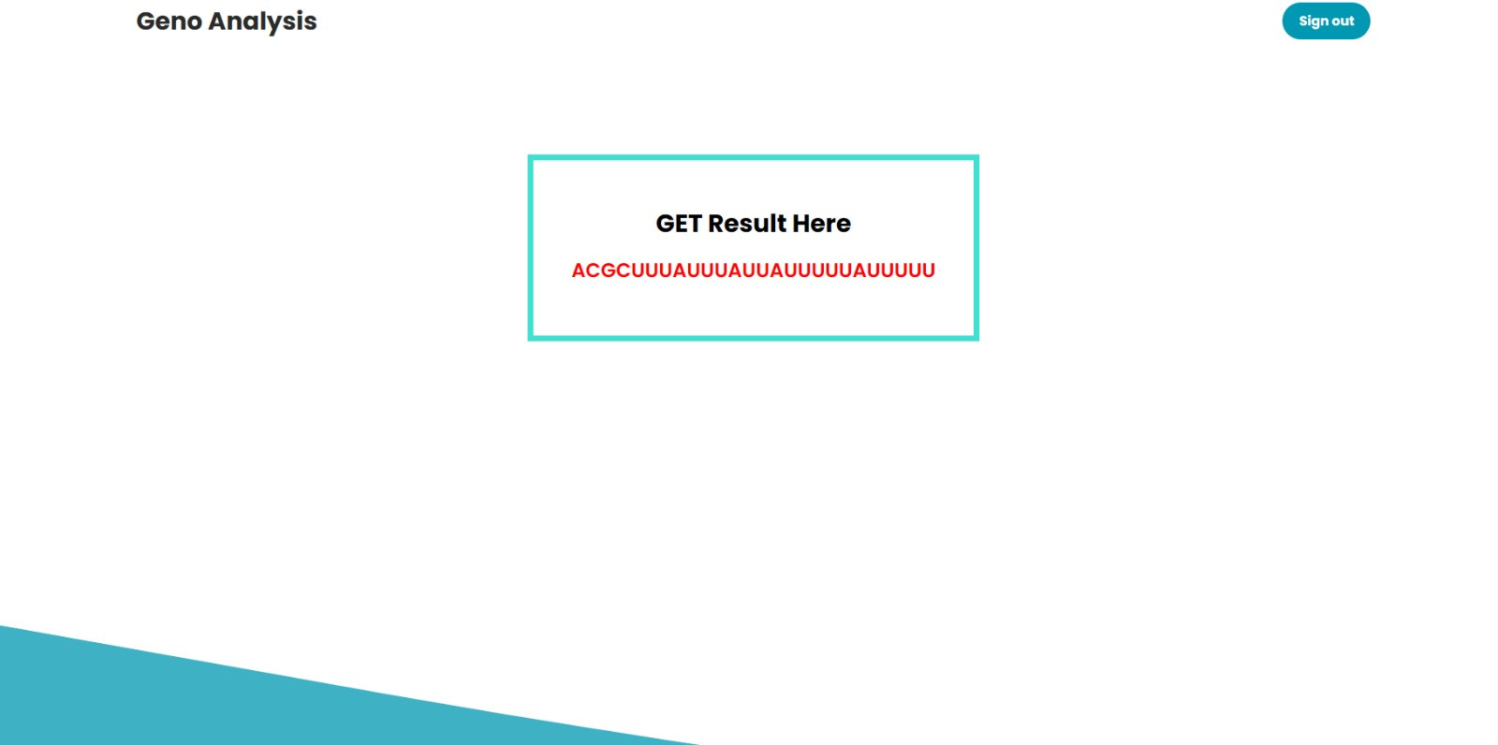
2-transcription

Slide 19

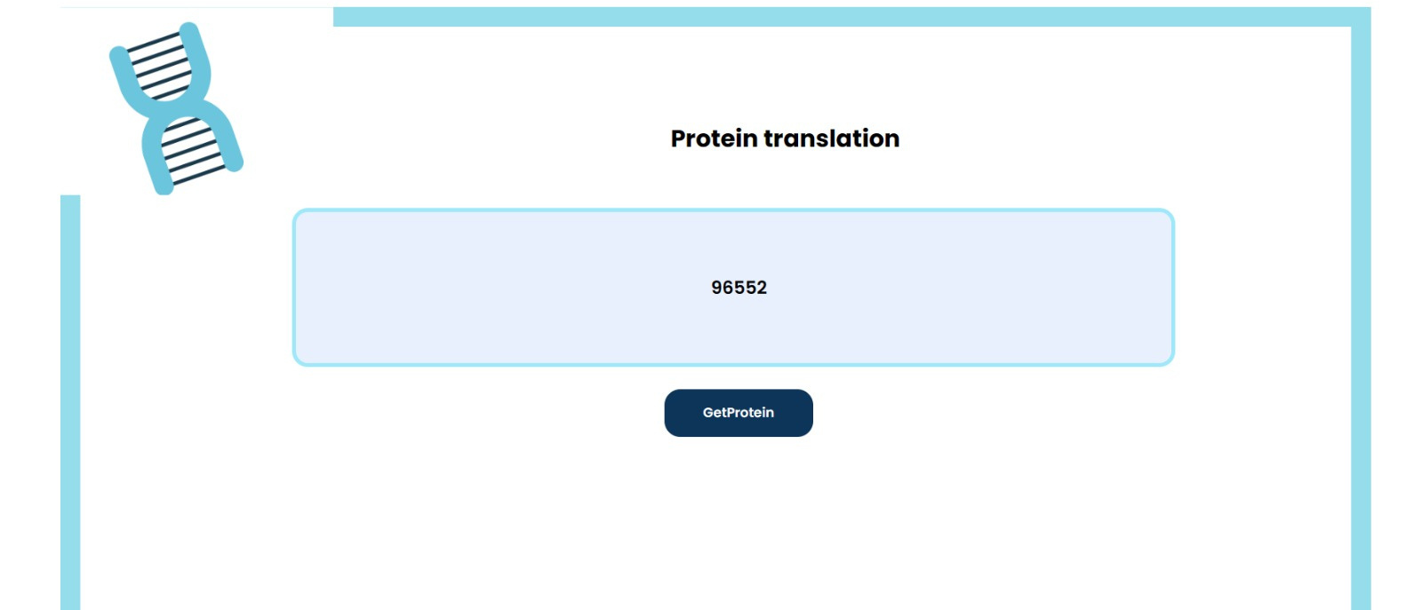
3-translation

Slide 20

3-translation

Slide 21
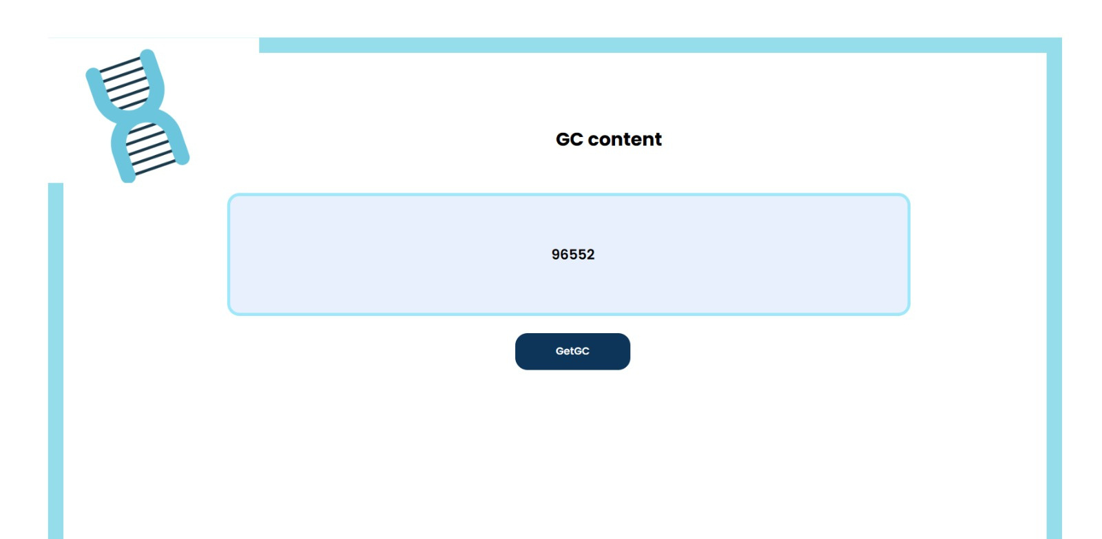
4-GC content

Slide 22
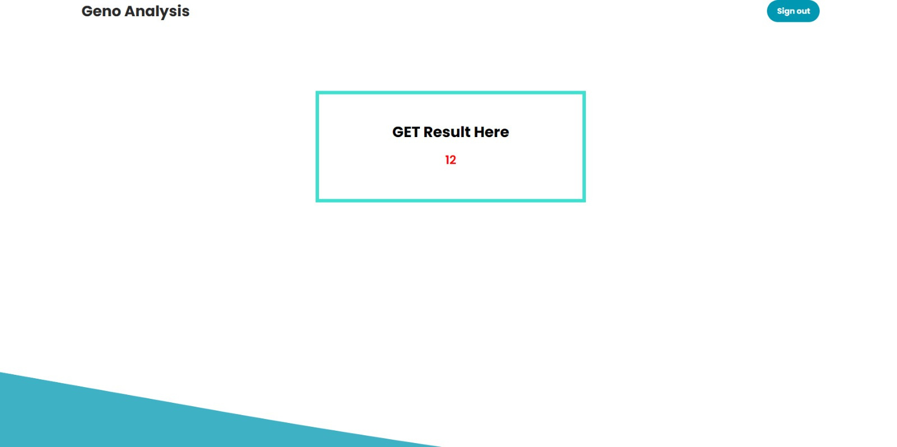
4-GC content

Slide 23

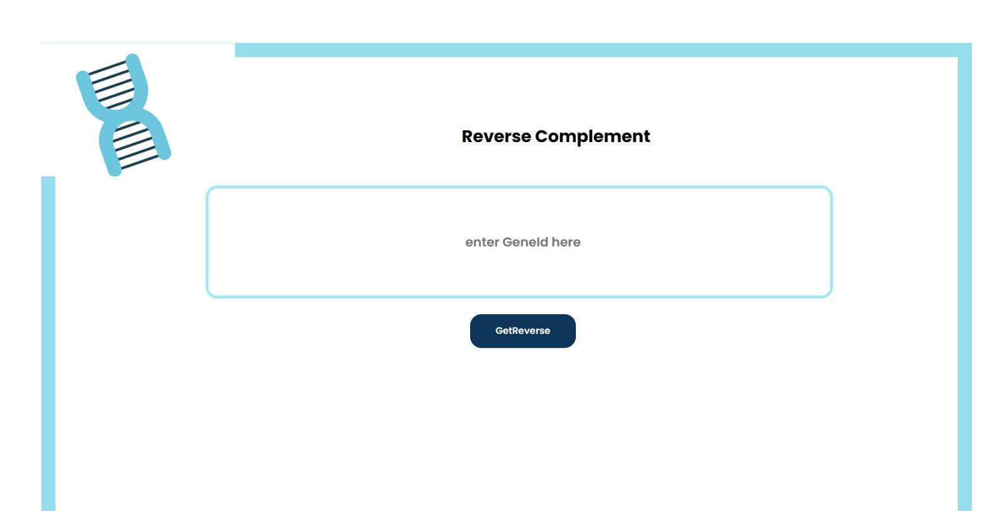
5-Reverse complement

Slide 24

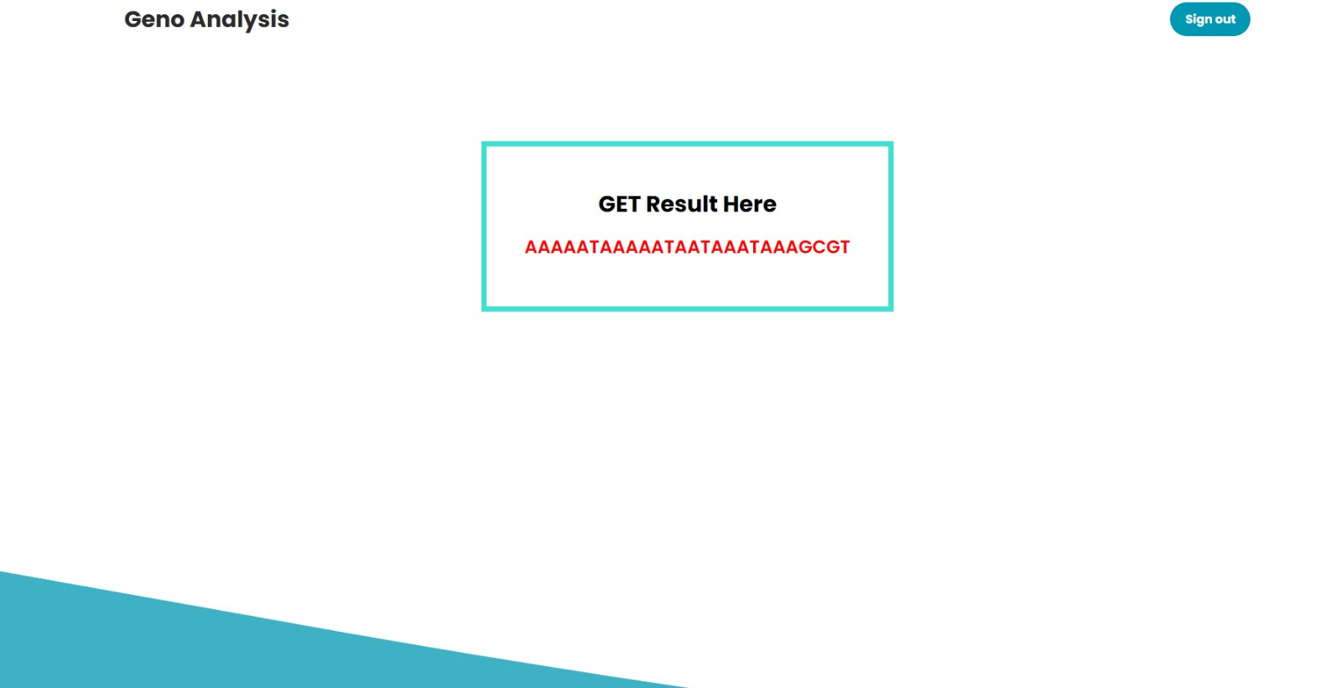
5-Reverse complement

Slide 25
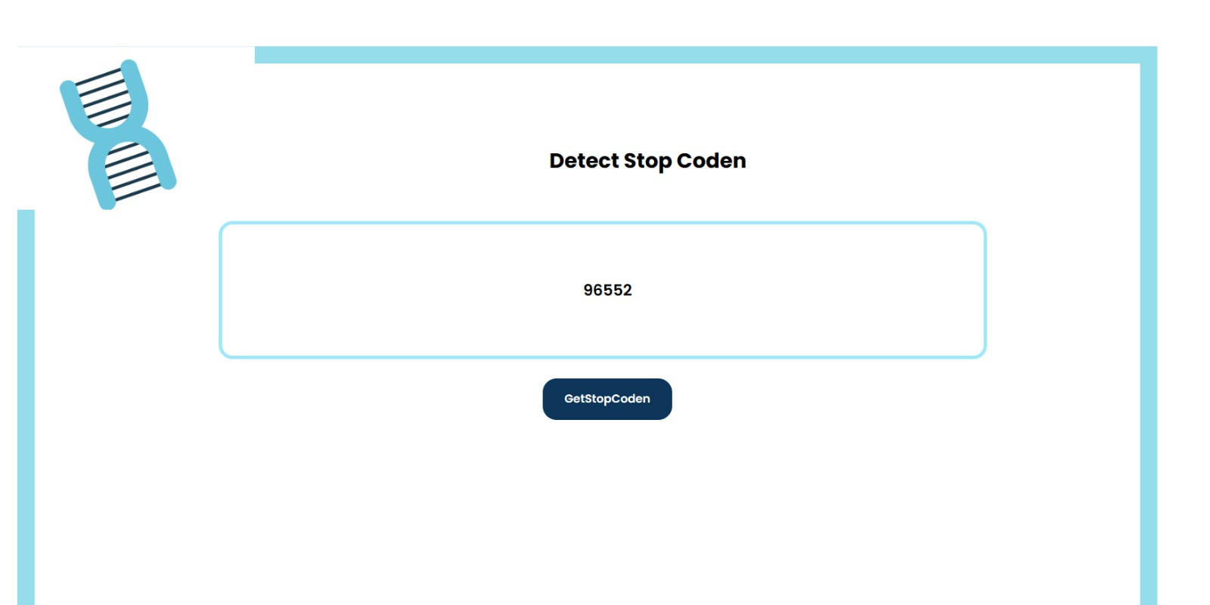
6-Stop codon

Slide 26
03
DATABASE CAPTURE

Slide 27
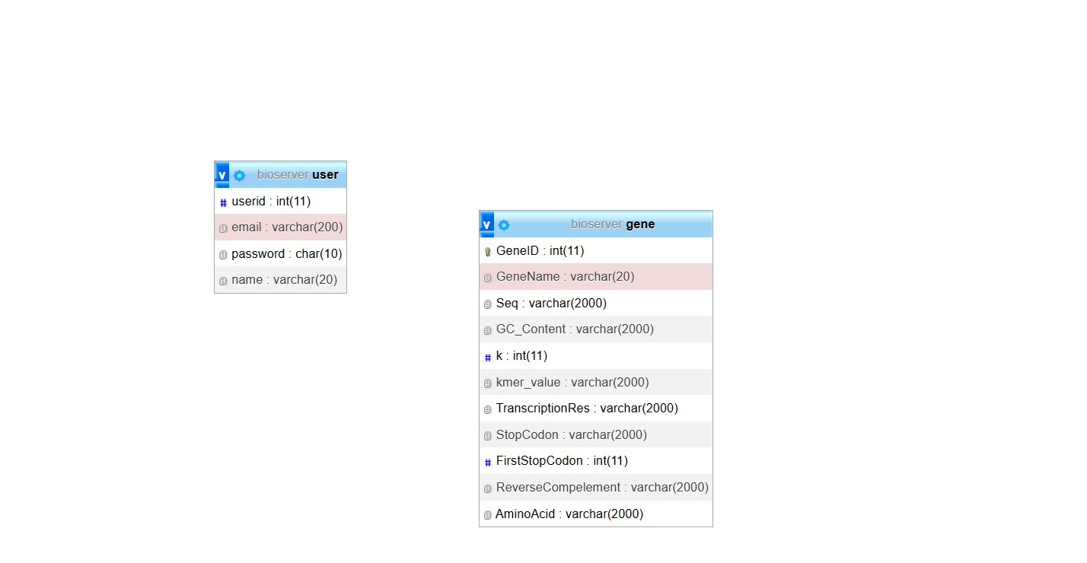

Slide 28
